Slide 1
Lesson 2 Business Process Change
ICS 3109
Business Process Re-engineering and Change Management

Slide 2
Introduction
Business processes are integral to delivering a business strategy.
Business analysis explores the way strategic action can be implemented through beneficial business process and structural change.
Organisations can achieve significant improvements in their competitiveness by successfully redesigning their business processes.
Existing processes in many organisations are less efficient than they could – or should be.

Slide 3
Business Processes and Strategy
Business processes are fundamental to an organisation’s success in producing its goods and services.
For an organisation to maximise its competitiveness it needs to have processes which are both well designed and which work effectively.
The outcome of a well-designed business process is increased effectiveness (value for the customer) and increased efficiency (lower costs for the business).
The general background to any review of business processes lies in Porter’s value chain model
Notes:
A value chain is a set of activities that an organization carries out to create value for its customers. Michael Porter discussed this in his influential 1985 book "Competitive Advantage," in which he first introduced the concept of the value chain.

Slide 4
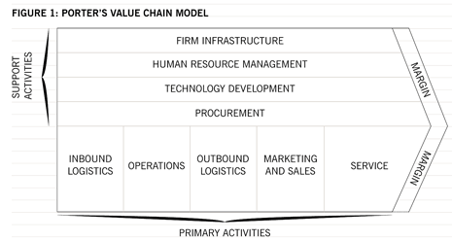
Porter’s Value Chain

Slide 5
Porter’s Value Chain
How these activities function and interrelate constitutes an organisation’s processes.
The process perspective on management involves understanding businesses in terms of their individual processes.
Slack et al defines a process as ‘an arrangement of resources that transforms inputs into outputs that satisfy (internal or external) customer needs’. “Satisfying customer needs” helps to highlight the common ground between processes and business strategy. Both seek to deliver value for the customer.
Although business strategy is concerned with developing financial and strategic performance, the underlying logic is that financial and strategic performance will be achieved by delivering value for the customer, and this value delivery will be achieved through process delivery.

Slide 6
Strategic Value of a Process Perspective
Alongside the overall goal of delivering value for the customer, the process perspective contributes to the strategic impact of a business in four ways:
Cost control – keeping costs under control by ensuring process efficiency.
Revenue – enhancing a business’s ability to generate revenue through the quality of the products and services it produces.
Investment – maximising the return on investments by ensuring that they operate as they are intended to.
Capabilities – embedding the capabilities that will form the basis of the business’s ongoing future competitiveness.

Slide 7
Strategic Value of a Process Perspective
Process-oriented organisations break down the barriers of structural departments and avoid functional ‘silos’ (each department concentrating only on its own function rather than understanding how it contributes to overall value creation in an organisation).
However, the strategic value of a process perspective comes from not only analysing current processes, but also identifying areas where they can be improved.
Business process improvement aligns processes in order to realise organisational goals.

Slide 8
Levels of a Process
There are three levels at which a process perspective can be used to analyse a business:
Strategic level – looking at the business, or its supply chain, as a whole.
Operational functions of the business – for example, looking at purchasing, marketing, or manufacturing operations.
Sub-operational processes – looking at individual processes within the operation’s functions; for example, placing television advertising within the marketing operation.

Slide 9
Levels of a Process
Most business processes can have sub-processes, each with their own attributes and components, but all contributing to the goal of the overall process.
Business process analysis typically includes mapping individual processes down to activity level.
At whatever level it is being considered, a business process begins with a customer’s need and ends with that need being fulfilled.
Service industries or service processes (e.g., accounts payable processing) offer as much opportunity for improvement as manufacturing processes have done over the last few decades, esp. within e-commerce.

Slide 10
Levels of Process Change
There are three levels at which process change can be considered:
Process re-engineering – used at strategic level when major threats or opportunities in the business’s external environment prompt a fundamental re-think of the core processes critical to the operation of the value chain.
Process redesign – an intermediate scale of change operation for medium-sized processes that require extensive improvement or change. Redesign efforts result in changed job descriptions and some new automation.
Process improvement – a tactical level incremental technique for developing smaller, stable, existing processes. It can often be undertaken using a Six Sigma approach.

Slide 11
Process Change
For process change to be efficient and effective, it is important that the level of process change is appropriate to the process under review.
However, the level of process change required is also likely to reflect the process capability maturity of the business.
If the business has mature process capabilities, process improvement efforts will be more or less continuous, undertaken by managers and their process teams.
If a business has a low degree of process maturity then a process redesign effort might be required to establish the initial process capabilities.

Slide 12
Process Redesign Patterns
Paul Harmon (2012) describes four basic process redesign patterns: re-engineering, simplification, value-added analysis, and gaps and disconnects.
Re-engineering: relates to a fundamental rethinking of existing processes to achieve major efficiency improvements.
Simplification: assumes that most established processes (or sub-processes) are likely to have developed elements of duplication or redundancy. Process efficiency can be improved by removing these.

Slide 13
Process Redesign Patterns
Value-added Analysis: looks at the process (or sub-process) from a customer’s perspective. A process or activity is said to add value if it meets three criteria:
the customer is willing to pay for the output
it physically changes the output in some way
it is performed correctly at the first attempt.
Non-value-adding activities should be eliminated as far as possible. These include:
preparation and set-up
control and inspection
simply moving a product from one place to another without physically changing it
activities that result from delays or failures of any kind.
Notes:
Obviously, some of these “non-value-adding activities (e.g. set-up activities) may be essential for the value-added activity to take place. These essential support activities are known as value-enabling activities, and cannot be eliminated altogether. However, they should be done simply and cost-effectively to allow resources to be focused as much as possible on the value-added activities.

Slide 14
Process Redesign Patterns
Gaps and Disconnects: most problems affecting process performance result from failure in communication between functions or business departments. This redesign pattern ensures that the appropriate checks and controls are in place so that efforts are coordinated between functions and departments.
E.g., if the production department builds a product and ships it to the customer, finance must be aware of this so that they can raise an invoice to the customer.

Slide 15
Lessons from Japanese Manufacturing
Japanese manufacturing techniques are often cited as models of efficiency as they increase quality and reduce costs, but some of the essential principles of Japanese manufacturing are actually only applications of these process redesign patterns.
The Japanese have embraced the underlying philosophy of minimising non-value-adding activities in the way described previously, but we can highlight three specific principles which also reflect Japanese redesign patterns:

Slide 16
Lessons from Japanese Manufacturing
Reducing wasteful activity (‘muda’) – this is one of the most important principles in Japanese manufacturing.
Waiting for someone to act; waiting while documents, information, or parts travel between locations; having to redo something to correct a mistake; having to redo something because requirements have changed: these are all examples of wasteful activity, and they will delay completion of the process.
Minimising these wasteful activities will lead to processes becoming more efficient and effective.

Slide 17
Lessons from Japanese Manufacturing
Reducing physical strain (‘muri’) – this principle usually addresses the reduction of unnecessary motion.
It seeks to identify where people have to work harder than necessary due to poor design in the production process which leads to repetitive actions.
Process mapping should help identify unnecessary steps that can be eliminated, or unnecessarily convoluted routings which can be simplified to reduce the level of ‘muri’ in a process.

Slide 18
Lessons from Japanese Manufacturing
Reducing inconsistencies (‘mura’) – this third principle highlights the important link between processes and quality alluded to in the value - added redesign pattern, but in the Japanese model it is shown more explicitly.
Inconsistencies in either the time taken to supply, or in the quality of, a product or service, will quickly lead to customer dissatisfaction.
Japanese automobile manufacturing manages the risk of inconsistencies through a combination of rigidity and flexibility, which may sound odd but which actually serves as a valuable lesson for process control.

Slide 19
Lessons from Japanese Manufacturing
For example, in Japanese automobile manufacturing factories, every shift has an output target, and the entire shift works overtime until the production quotas are completed.
However, if a mistake is made, the entire production line comes to a halt until the root cause of the problem is fixed, eliminating the need for reworking and corrections further down the production line.
The system is therefore designed to provide inherent quality assurance over the quality of its outputs.

Slide 20
Process Design and Quality
To ultimately to satisfy customer needs, the link between processes and quality is important. Remember ‘Business process re-engineering is the fundamental rethinking and radical redesign of business processes to achieve dramatic improvements in critical contemporary measures of performance, such as cost, quality, service and speed.’
If the needs and expectations of every customer are consistently met or exceeded, then a process has achieved total quality.
Two main models are used to improve business processes – Capability Maturity Model Integration (CMMI) and Six Sigma

Slide 21
CMMI Model
Developed by the Software Engineering Institute, part of Carnegie Mellon University in Pittsburgh, USA. The CMMI principal is that “the quality of a system or product is highly influenced by the process used to develop and maintain it”.
CMMI can be used to guide process improvement across a project, a division, or an entire organization. It provides:
Guidelines for processes improvement
An integrated approach to process improvement
Embedding process improvements into a state of business as usual
A phased approach to introducing improvements

Slide 22
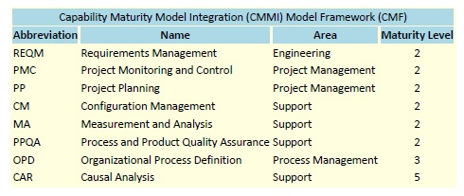
CMMI Model
There are five CMMI maturity levels. However, maturity level ratings are only awarded for levels 2 through 5.
Level 2 – Managed, Level 3 – Defined, Level 4 – Quantitatively Managed, Level 5 – Optimizing

Slide 23
CMMI Model
The fundamental logic behind CMMI is that immature organisations don’t perform consistently, but mature organisations produce quality products and services effectively and consistently.
‘An immature... process resembles a Little League baseball team. When the ball is hit, some players run towards the ball, while others stand and watch, perhaps not even thinking about the game. In contrast, a mature organisation is like a professional baseball team. When the ball is hit, every player reacts in a disciplined manner. Depending on the situation, the pitcher may cover home plate, infielders may set up for a double play, and outfielders prepare to back up their teammates.’ – Watt Humphrey

Slide 24
CMMI Model
The CMMI as a reference model helps businesses understand their current process capabilities, in order to develop a plan to get where they want to be.
But it doesn’t prescribe how they get there.

Slide 25
Six Sigma Model
A methodology that can be used by project teams to actually improve a process, using the five-stage DMAIC pattern:
Define the problem, improvement activity, opportunity for improvement, the project goals, and customer (internal and external) requirements.
Measure process performance.
Analyze the process to determine root causes of variation, poor performance (defects).
Improve process performance by addressing and eliminating the root causes.
Control the improved process and future process performance.

Slide 26
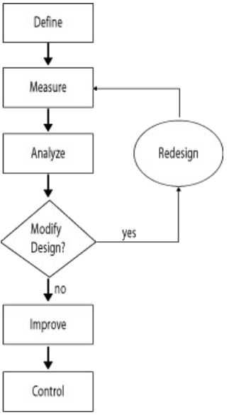
Six Sigma Model
One of the techniques that can be used in the analysis phase is the business process or (workflow) diagram.
The diagram is divided into horizontal rows, which are called ‘swimlanes’, with each organisational department or function having its own swimlane.
The diagram can then be used to show how all the activities and functions within a process fit together, with the processing beginning on the left of the diagram and proceeding to the right.

Slide 27
Six Sigma Model
The essential goal of Six Sigma is to eliminate defects and waste, thereby improving quality and efficiency, by streamlining and improving all business processes.
A sigma rating indicates the percentage of defect-free products created by a process. A six sigma process is one in which 99.99966% of all production opportunities are expected to be free of defects.
The model was first designed for manufacturing and became central to General Electric's business strategy in 1995. Today the health care industry uses Six Sigma to increasing the reliability of the process of delivering health care services.

Slide 28
Example 1
Diskus is a company that sells CDs and DVDs by mail order.
Customer orders are received by the sales team that checks that customer details are completed properly on the order form (e.g., delivery address and method of payment). If they are not, a member of the sales team contacts the customer to get the correct details.
Once the correct details are confirmed, the sales team passes a copy of the order through to the warehouse team to pick and pack, and a copy to the finance team to raise an invoice.
Finance raises an invoice and sends it to the customer within 48 hours of the order being received.

Slide 29
Example 1
When a member of the warehouse team receives the order, they check the real-time inventory system to make sure the discs ordered are in stock.
If they are, they are collected from the shelves, packed and sent to the customer within 48 hours of the order being received, so that the customer receives the goods at the same time as the invoice.
If the goods are not in stock, the order is held in a pending file in the warehouse until the stock is replenished, whereupon the order is fulfilled.
This process can be illustrated as follows:

Slide 30
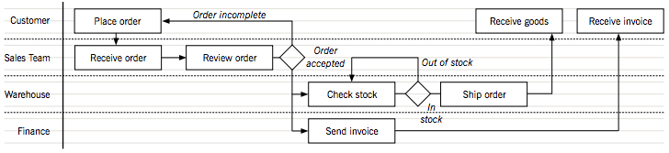
Example 1
The process diagram highlights two major problems in the order fulfillment process:
There is no communication between finance and the warehouse to confirm discs are in stock so that the order can be shipped. Therefore finance could be raising invoices when the order has not been sent. This is an example of a gap or disconnect.
The discs and the invoices are sent independently of each other, meaning that Diskus will be duplicating its postage costs. Sending the invoice is not a value-added activity. The customer will not be willing to pay the invoice without the discs.

Slide 31
Example 1
The process can be redesigned so that invoices are only raised for discs that are sent to the customer, and that the invoice and the discs are sent together.
To solve the first problem, finance could set up pending invoices when they are notified of an order by the sales team, but the invoices would only be generated as ‘live’ when the warehouse confirms that the discs are in stock and the order can be fulfilled.
To solve the second problem, a member of the warehouse team could be assigned to collate all outgoing orders. Finance could then send the invoice to that person, who could match the invoice to the order, and then send them both out to the customer together.

Slide 32
Example 1
This is a very simple example, and real-life processes are often more complex, but it still illustrates the way a process diagram helps managers analyse business processes to remove duplication, non-value-added activities, and gaps and disconnects.
This makes the process more efficient internally, but more importantly, means the customer is prepared to pay for the output.

Slide 33
Conclusion
Organisations need effective and efficient business processes in order to successfully implement their business strategies.
While the ‘mechanics’ of any improvement will often be inward-looking (analysing the process itself), the motive for the improvements must come from satisfying customer needs. That is what delivers value to the organisation.

Slide 34
Exercise
Examine the process map of a current business process in the next slide.
Describe the scenario and identify any problems and how they could be overcome. Use the patterns identified from this lesson to address your solutions.

Slide 35
